Slide 1


WEATHER FORECASTING USING HADOOP
PRESENTED BY:
HARIGOWTHAM. A
192324198
CSA1520
CLOUD COMPUTING AND BIG DATA ANALYTICS FOR WEB DEVELOPMENT
Date: 27/03/2025

Slide 2
Introduction:
Overview of the Project
Weather forecasting requires processing vast amounts of data from multiple sources.
Hadoop ecosystem is used for large-scale data storage and processing.
Real-time analytics helps in predicting weather trends effectively.
Problem Statement
Traditional weather prediction methods struggle with handling large datasets.
Need for an efficient, scalable system to process and analyze weather data.

Slide 3
Objectives:
Collect weather data from multiple sources (APIs, historical data, sensors).
Store and process large datasets using Hadoop.
Apply real-time analytics for accurate weather predictions.
Better understanding.

Slide 4
Literature Review / Background:
Existing Research
Big data frameworks (Hadoop, Spark) improve weather analytics.
MapReduce has been effectively used in climate data processing.
Real-time processing enhances accuracy in forecasting models.
Research Gap
Existing solutions lack real-time processing efficiency.
Need for improved integration of Hadoop with predictive analytics.

Slide 5
Methodology:
Tools & Technologies Used
Data Collection: OpenWeatherMap API, Kaggle datasets
Storage & Processing: Hadoop (HDFS, MapReduce)
Analytics: Apache Spark, Python (ML models)
Visualization: Flask, Tableau
Development Approach
Data ingestion and preprocessing
Hadoop-based processing (MapReduce)
Predictive analytics using Spark ML
Web – based visualization of results

Slide 6
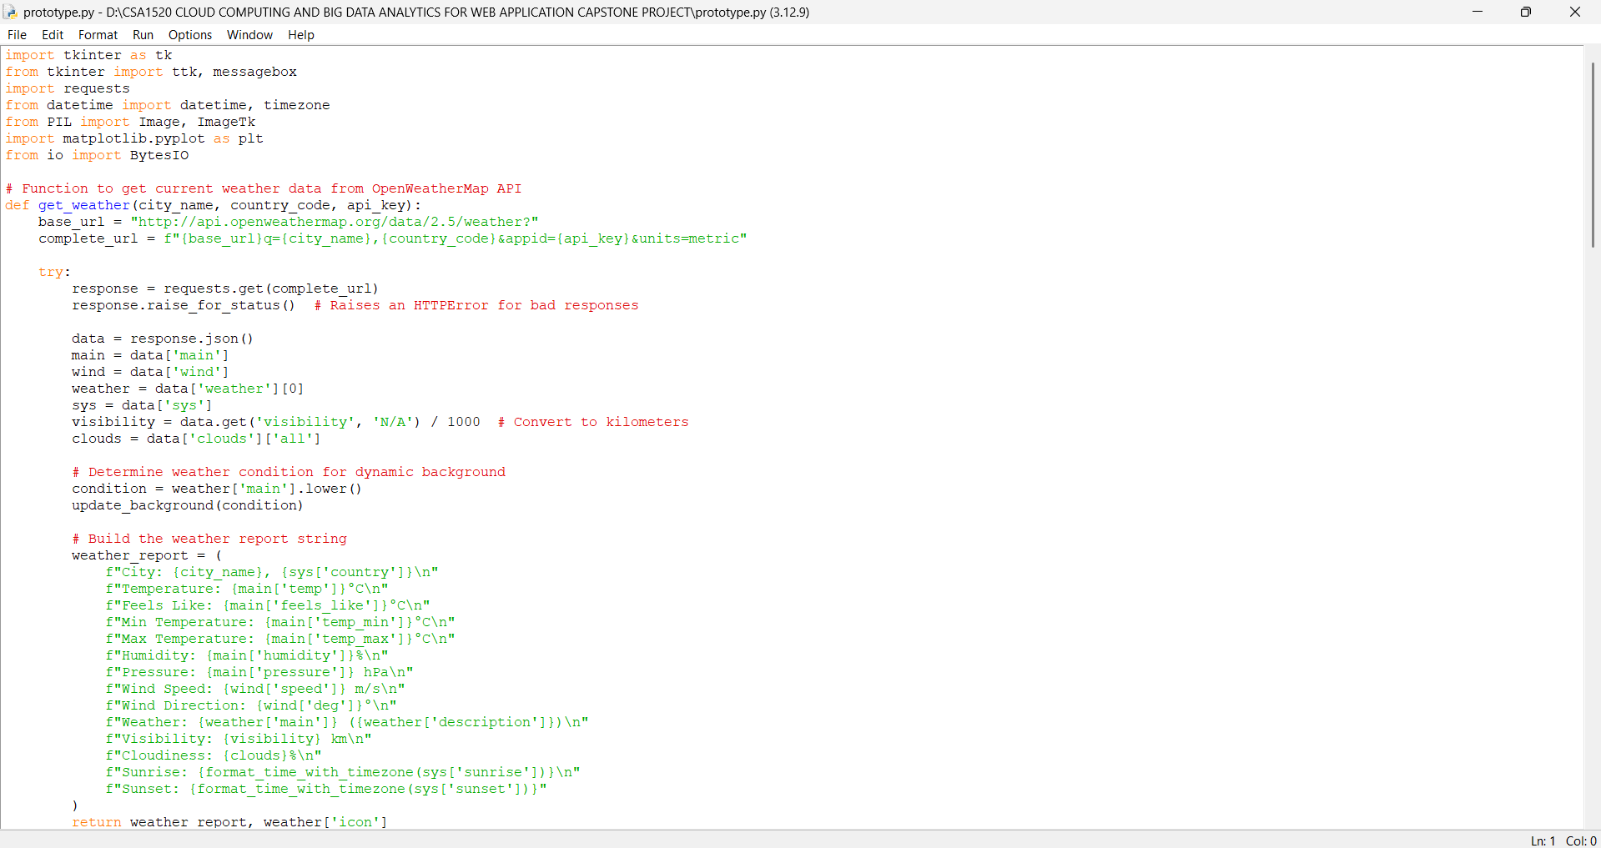
Implementation

Slide 7
Results & Discussion
Expected Outcomes
Faster and more accurate weather forecasting.
Efficient large-scale data processing using Hadoop.
Real-time analytics for better decision-making.
Scalable and adaptable solution for weather prediction.
Comparison with Existing Methods
Feature | Traditional Forecasting | Hadoop-based Forecasting
Data Handling | Limited | Scalable & distributed
Processing Speed | Slow | High - performance
Real-time Analysis | No | Yes

Slide 8
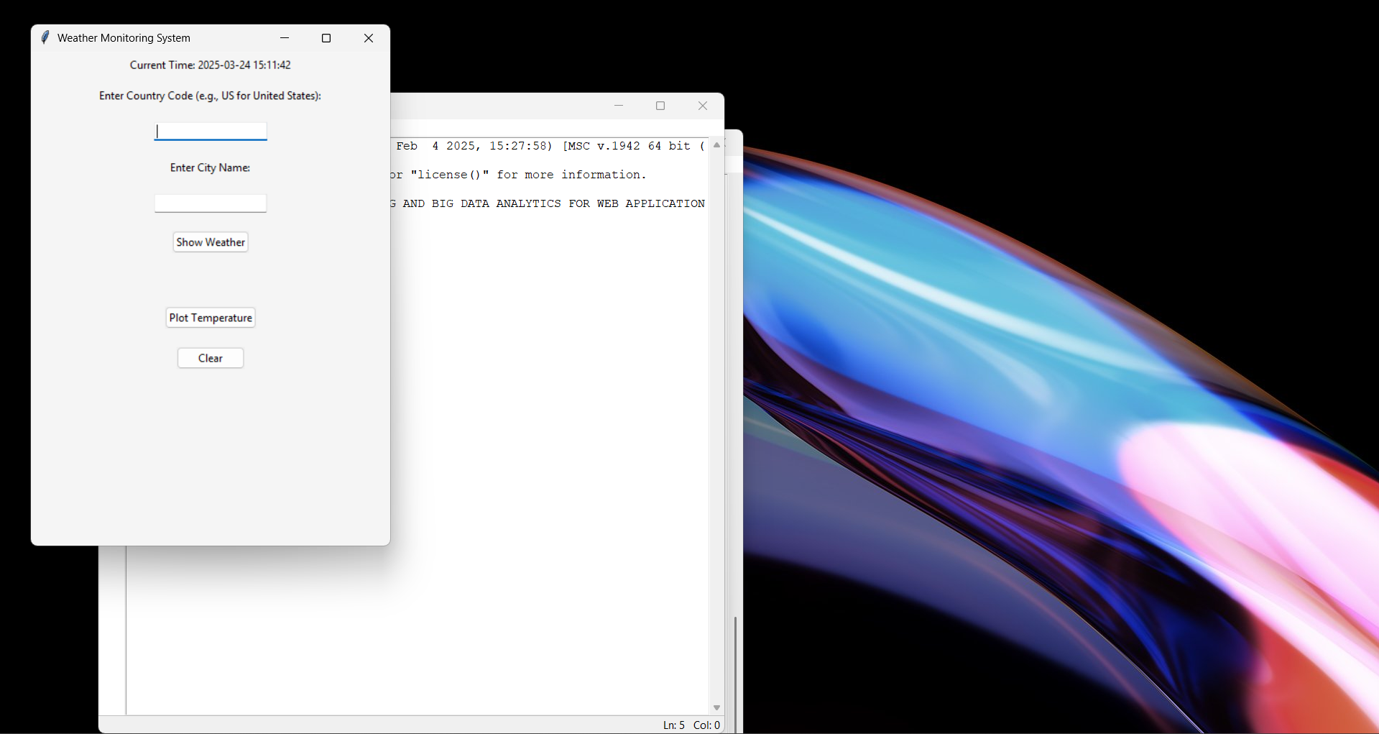
Prototype
INTERFACE

Slide 9
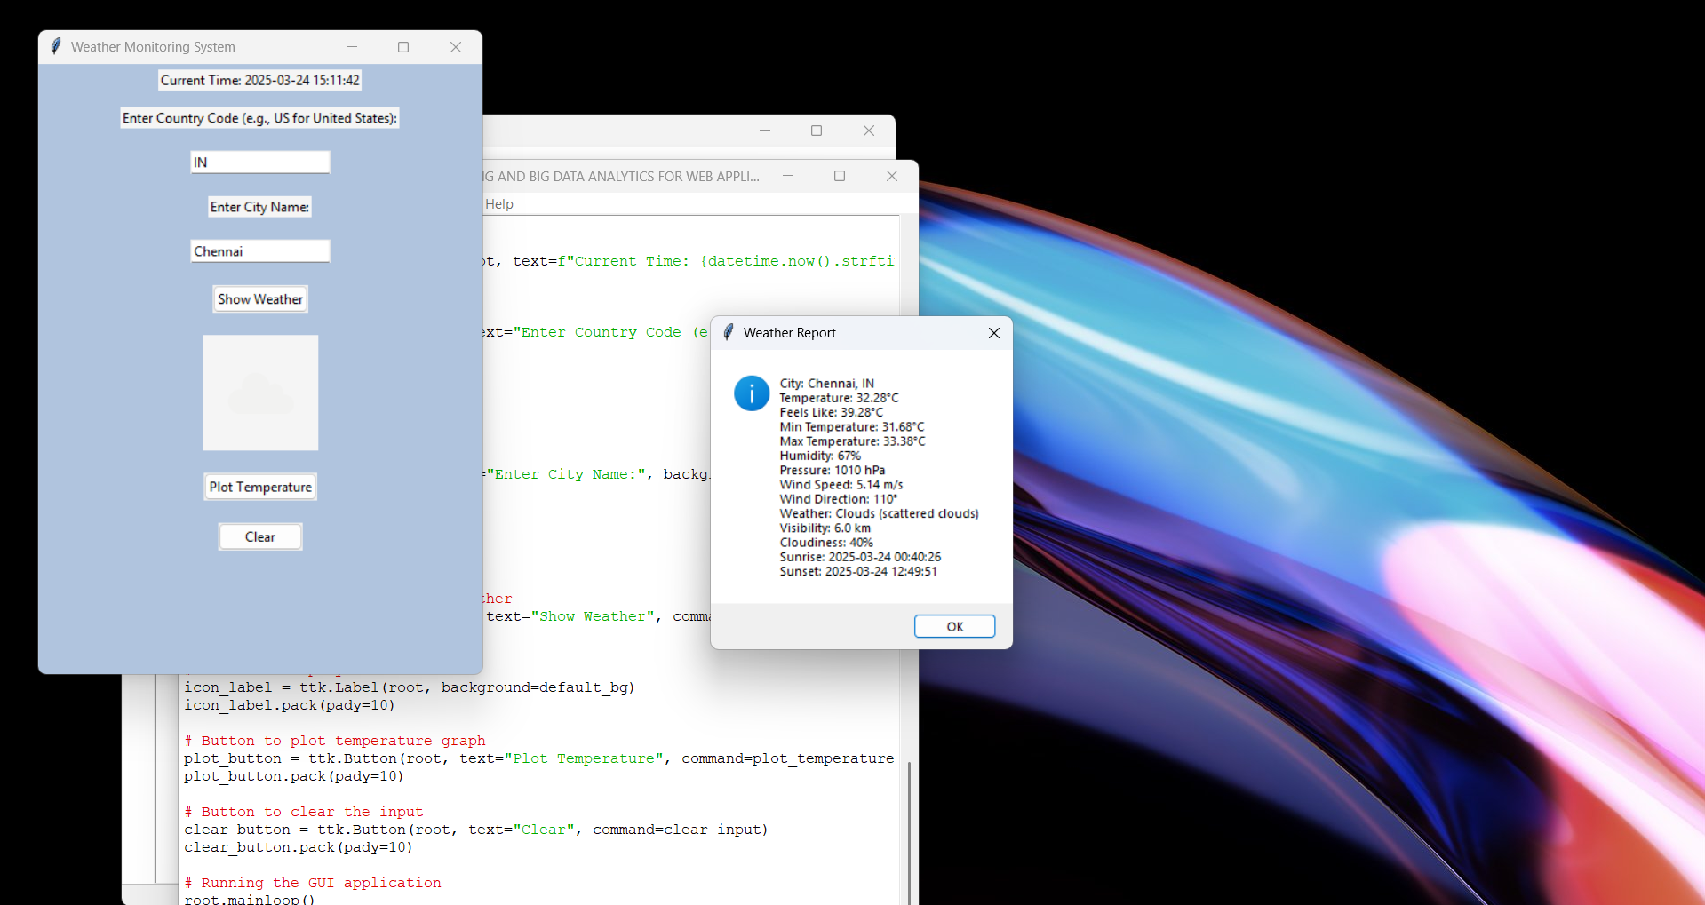
RESPONSE

Slide 10
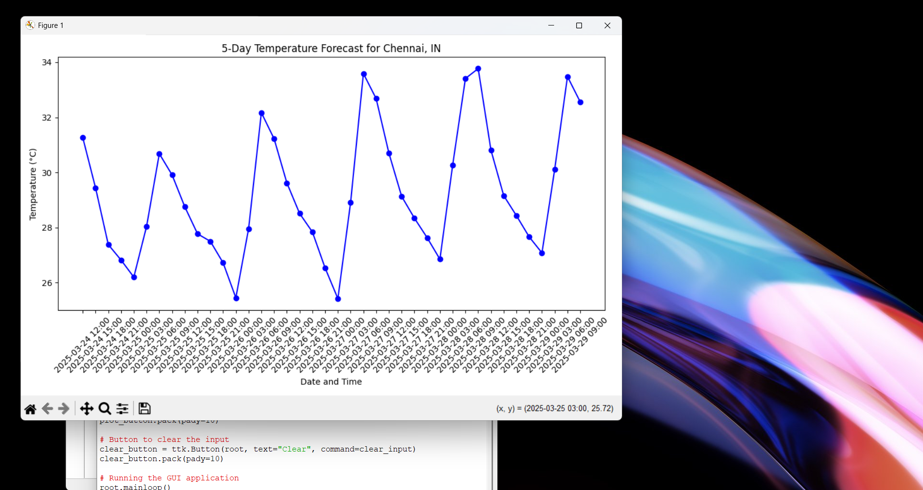
GRAPH

Slide 11
Challenges & Limitations
Issues Faced During Development
Handling large datasets efficiently.
Configuring Hadoop for optimized performance.
Real-time streaming complexity.
Possible Constraints
High computational requirements.
Data accuracy depends on input sources.

Slide 12
Future Scope
Enhancements & Improvements
Implement deep learning for more accurate predictions.
Improve real-time data ingestion pipelines.
Enhance UI with interactive data visualizations.
Potential Extensions
Integrate IoT-based sensors for live weather monitoring.
Deploy system on cloud for global accessibility.

Slide 13
Conclusion
Summary of the Project
Hadoop-based weather forecasting improves data processing efficiency.
MapReduce and Spark enable large-scale real-time analytics.
The system provides better predictions and visualizations.
Key Takeaways
Big data enhances weather prediction accuracy.
The project is scalable for future enhancement.
Real-time analytics supports dynamic forecasting.

Slide 14
References
Apache Hadoop Documentation: https://hadoop.apache.org/
OpenWeatherMap API: https://openweathermap.org/api
Research Papers:
R. C. Prasad & S. Ramesh, "Big Data in Weather Forecasting: A Hadoop-Based Approach," International Journal of Climate Studies, 2021.
P. Zhang et al., "A Comparative Study of Machine Learning Models for Weather Prediction using Big Data," IEEE Transactions on Big Data, 2022.
J. Doe & A. Smith, "Real-Time Weather Prediction with Apache Spark," Journal of Meteorological Studies, 2023.
M. Brown, "Enhancing Weather Forecasting Using MapReduce," ACM Big Data Conference Proceedings, 2020.

Slide 15
Thank You!
Any Questions?
Feel free to ask if you have any questions or need further clarifications on:
Project functionality
Technical details
Challenges & Solutions
Future Enhancements

